Slide 1
SPAN OF CONTROL ORGANIZATIONAL STRUCTURES
FACULTY: YADHU G

Slide 2
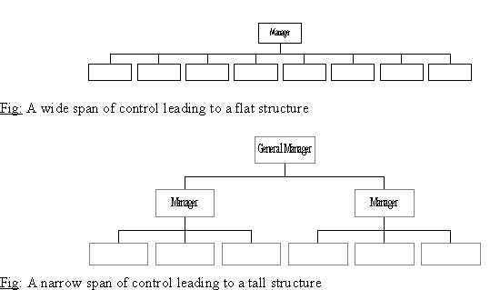
SPAN OF CONTROL
It’s the number of people or employees who are reporting to a manager directly.
Also called as Span of management or management ratio.

Slide 3
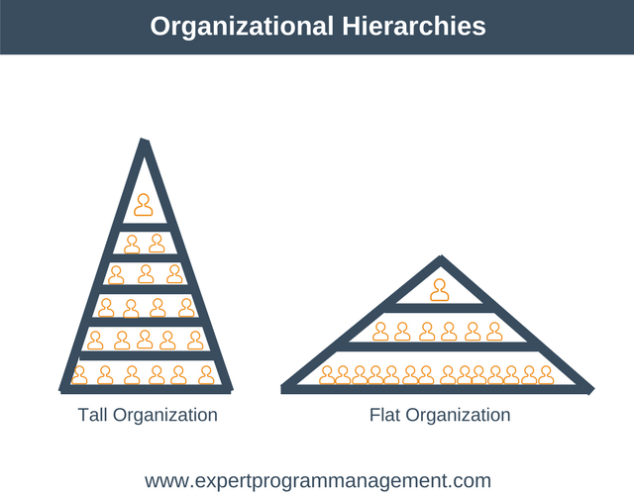
TYPES
WIDE /FLAT
More people under one manager.
Management ratio can be high (1:20).
Quick decision making is possible.
More suitable for dynamic environment.
NARROW /TALL
Less people under one manager.
Organized and people oriented structure.
Suitable for stable and predictable system.
Disadvantages-High administrative overheads, slow communication and decision making.

Slide 4
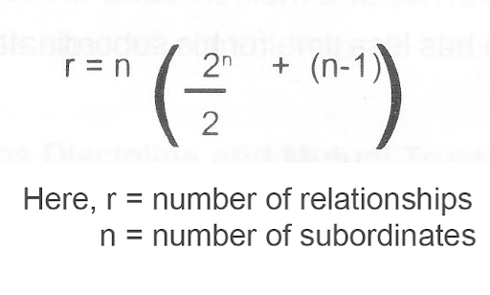
GRAICUNA’S THEORY OF SPAN OF MANAGEMENT
Graicunas, suggested that when the number of subordinates increases then there is an increase in the Direct Single Relationships, Direct Group Relationships and Cross Relationships.
So, as the number of subordinates increases arithmetically, the number of relationships among them also increases almost geometrically.

Slide 5
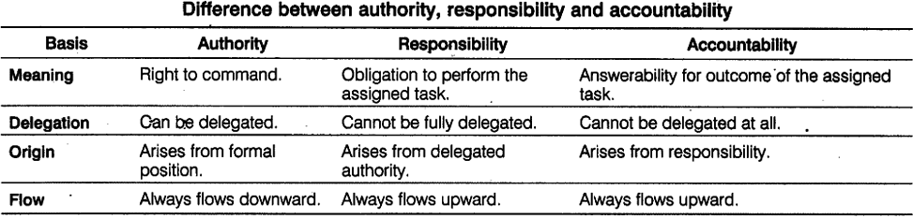
AUTHORITY AND RESPONSIBILITY

Slide 6
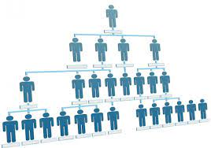
ORGANIZATIONAL STRUCTURE
It is the systematic arrangement of people working for the organization and their relationship between positions.
TYPES
LINE OS
LINE AND STAFF OS
FUNCTIONAL OS
PROJECT OS
MATRIX OS

Slide 7
LINE ORGANIZATION
Line Organization is also called military or scalar organization.
Authority flows from top to bottom in a vertical line.
Unity of command is maintained.
APPLICATION
Small concerns /businesses
Automatic and continuous process industries such as paper, sugar, cement, textile, etc.
Educational institutions

Slide 8
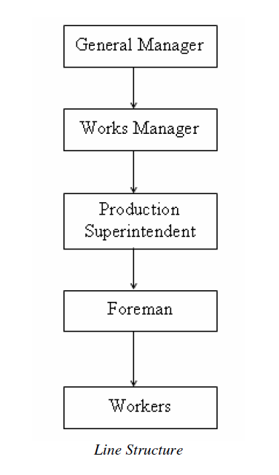
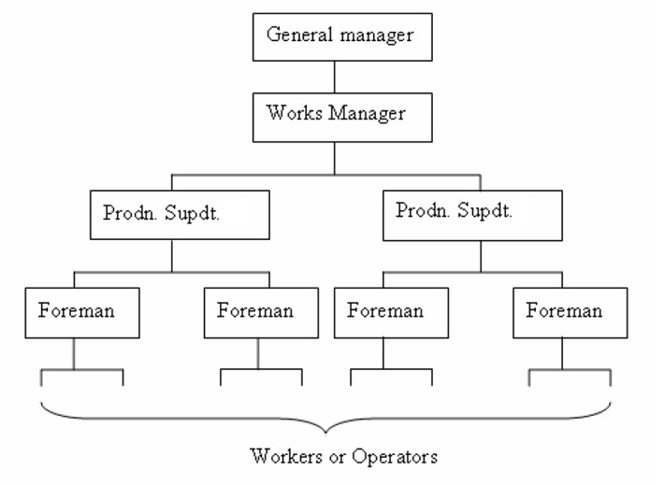
LINE ORGANIZATION

Slide 9
Advantages of Line structure
Simple OS
Clear cut authority and responsibility
Strong discipline
Capable of developing all round executives at higher levels of authority.
Disadvantages of Line structure
Neglects specialists
Overloads a few important executives
Encourages dictatorial way of working

Slide 10
LINE AND STAFF ORGANIZATION
In a big organization manager will have to do a variety of functions and he may not be expertise in all areas.
Special executives will be employed to assist line executives and they were known as staff, whom to perform specialized function.
Supervisory authority will be given for line executives and the staff executives gives advices and expert opinion, have no direct authority.
APPLICATION- Steel plant, Automobile plant

Slide 11
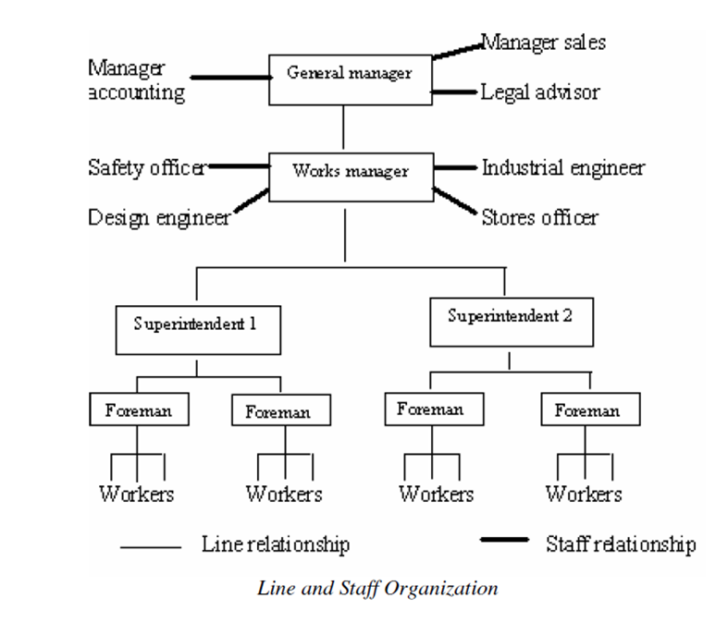

Slide 12
Advantages of Line and staff organization
Specialization benefits of staff can be profitably utilized to have standard operations.
Line executives are relieved of some of their workloads and are thus able to concentrate on other important matters.
Disadvantages of Line and staff organization
Staff – line conflict
Increased product cost because of high salaries of staff executives
Too much staff activity may complicate a line executive’s job of leadership and control

Slide 13
FUNCTIONAL ORGANIZATION
Introduced by F. W Taylor
Employees are grouped and located by specialty into functional departments: each headed by a functional manager. Each member of staff has one clear boss.
Authority rests with functional heads
Functional manager are specialists in their respective areas and is based on high degree of specialization.
This specialization leads to greater efficiency and refinement of particular expertise.

Slide 14
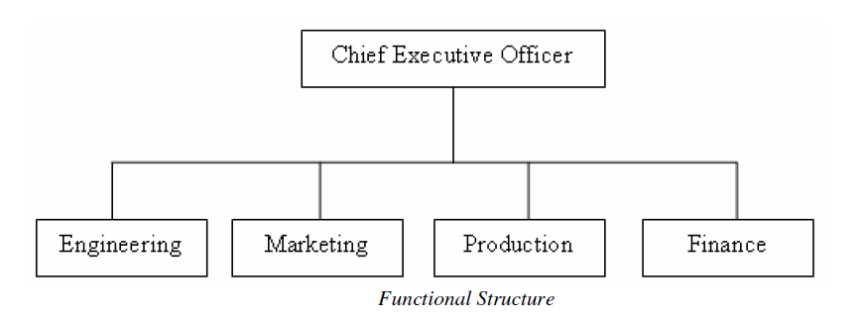
FUNCTIONAL ORGANIZATION

Slide 15
Advantages of Functional organization
Efficient use of resources
Simplifies training
Centralized control of strategic decisions
Improved quality of work
Disadvantages of Functional organization
Limits development of general managers or all-round executives
Difficulty in multifunctional decision making
Promotes narrow specialization

Slide 16
PROJECT ORGANIZATION
Firms dealing with multiple products or different projects usually adopt project organization.
It consist of an autonomous project team, existing independently of the rest of organization.
The emphasis in project organization is on creation of teams for the accomplishment of specific objectives.
The project team is assembled for a specific project under the action of project manager.
The team is thus temporary and will be dispersed when the project is completed.

Slide 17
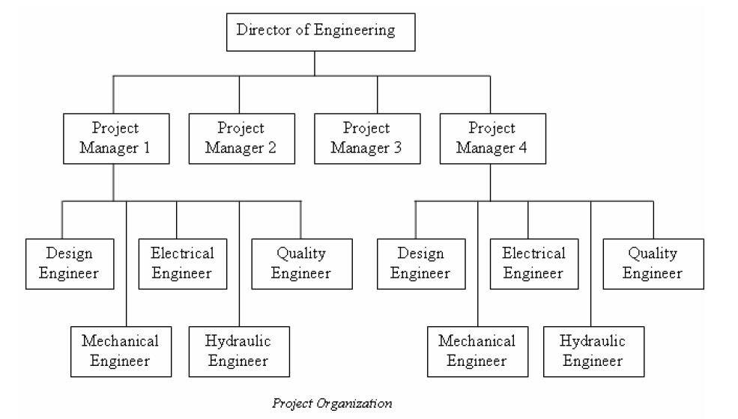
PROJECT ORGANIZATION

Slide 18
Advantages of Project Organization
Flexibility
Responsive to changing environment
Encourages team work
Disadvantages of Project Organization
Projects can be of short duration leading to frequent change in organization structure
Trained professionals need not tolerate the insecurity of frequent organization change

Slide 19
MATRIX ORGANIZATION
They are those that comes between fully functional and fully project organizational structure.
The matrix organization is an organization structure that establishes two chains of command, one vertical and one horizontal, at the same time.
It is intended to combine the advantages of functional structure and project structure.
APPLICATION –IT industries ,R&D

Slide 20
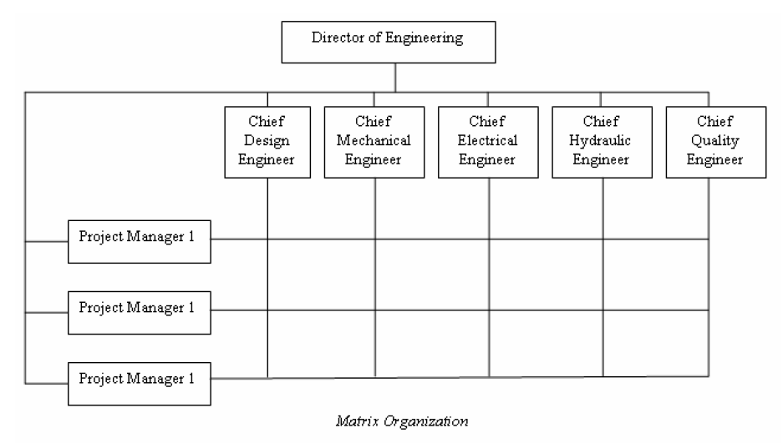
MATRIX ORGANIZATION

Slide 21
Advantages of Matrix Organization
Decentralized decision making
Capable of adapting to fast environmental changes
Flexibility
Disadvantages of Matrix Organization
Violates the principle of unity of command
High administrative costs
Requires tremendous horizontal and vertical co-ordination
Chances of interpersonal conflicts

Slide 22


